Slide 1
Online Retail Segmentation
Data Mining Final Project
Presented by: Aftab Nafees
GitHub: https://shorturl.at/5tZOf

Slide 2
Table of Contents
1. Introduction
2. Beginner Queries
3. Advanced Queries
4. Conclusion

Slide 3
Introduction
- Objective: Perform customer segmentation using data mining techniques (SQL).
- Dataset Description:
- 581,587 rows of transaction-level data.
- Key variables: InvoiceNo, StockCode, Quantity, InvoiceDate, UnitPrice, CustomerID, Country.

Slide 4
Beginner Queries Overview
1. Metadata Definition
2. Distribution of Order Values
3. Unique Products Purchased
4. Single Purchase Customers
5. Commonly Purchased Products Together

Slide 5
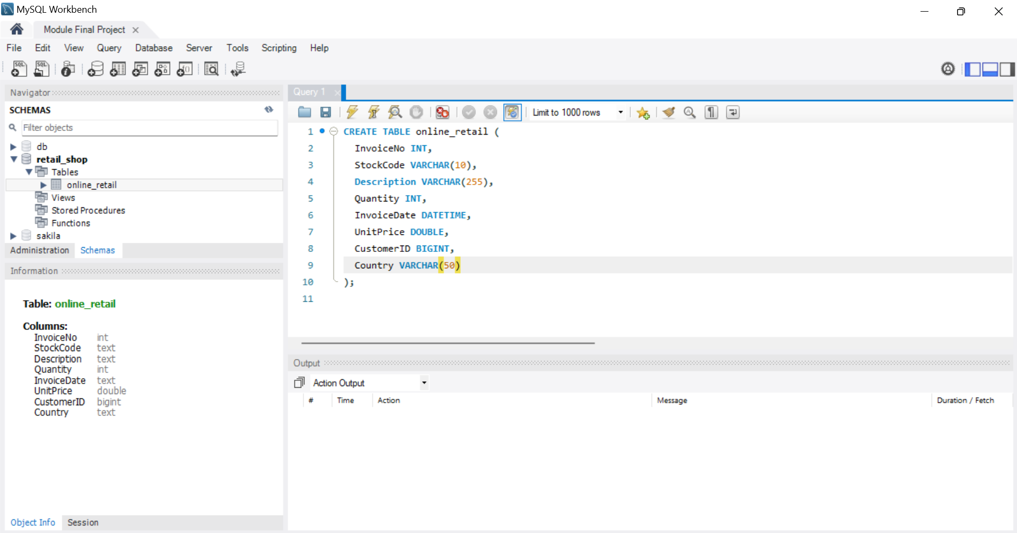
Metadata Definition

Slide 6
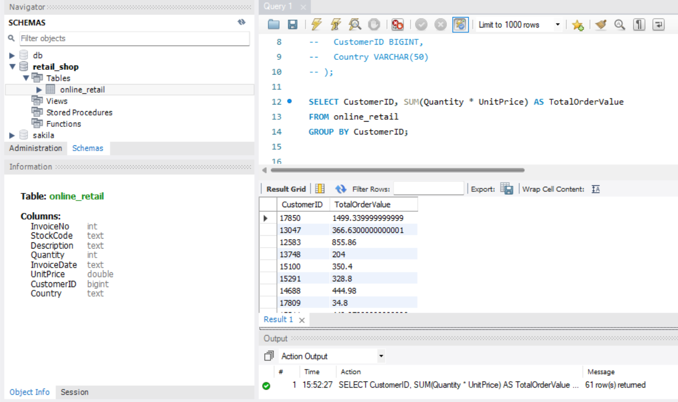
Distribution of Order Values

Slide 7
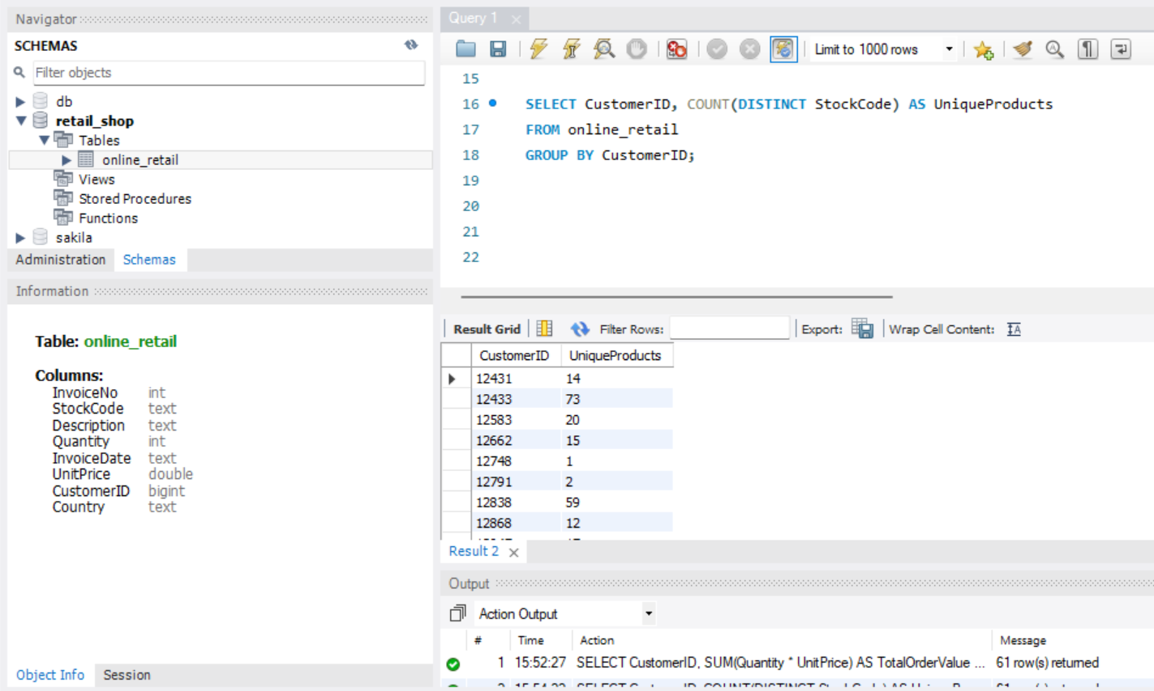
Unique Products Purchased

Slide 8
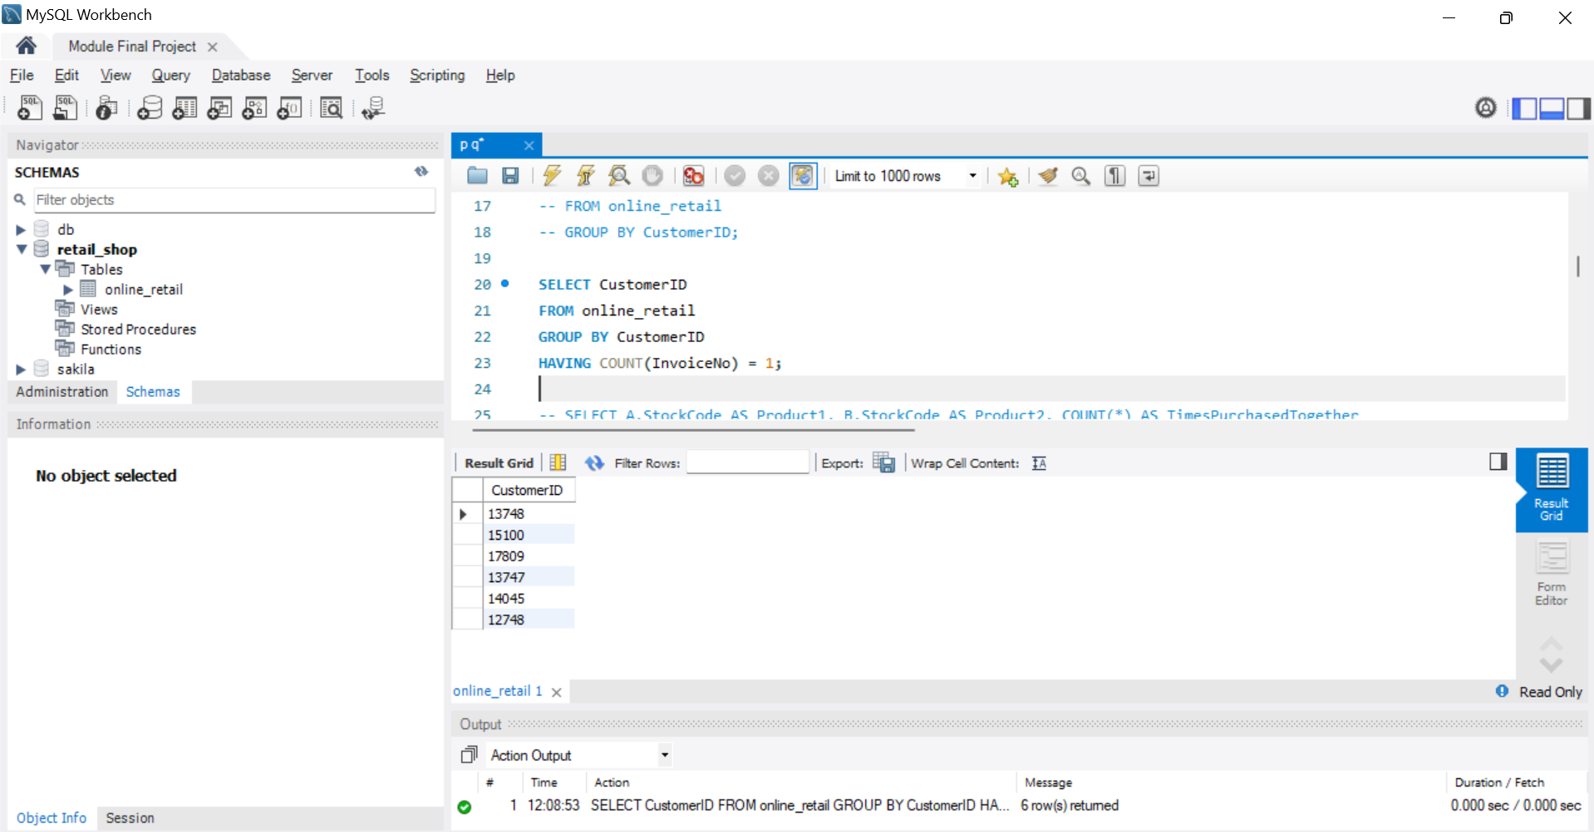
Single Purchase Customers

Slide 9
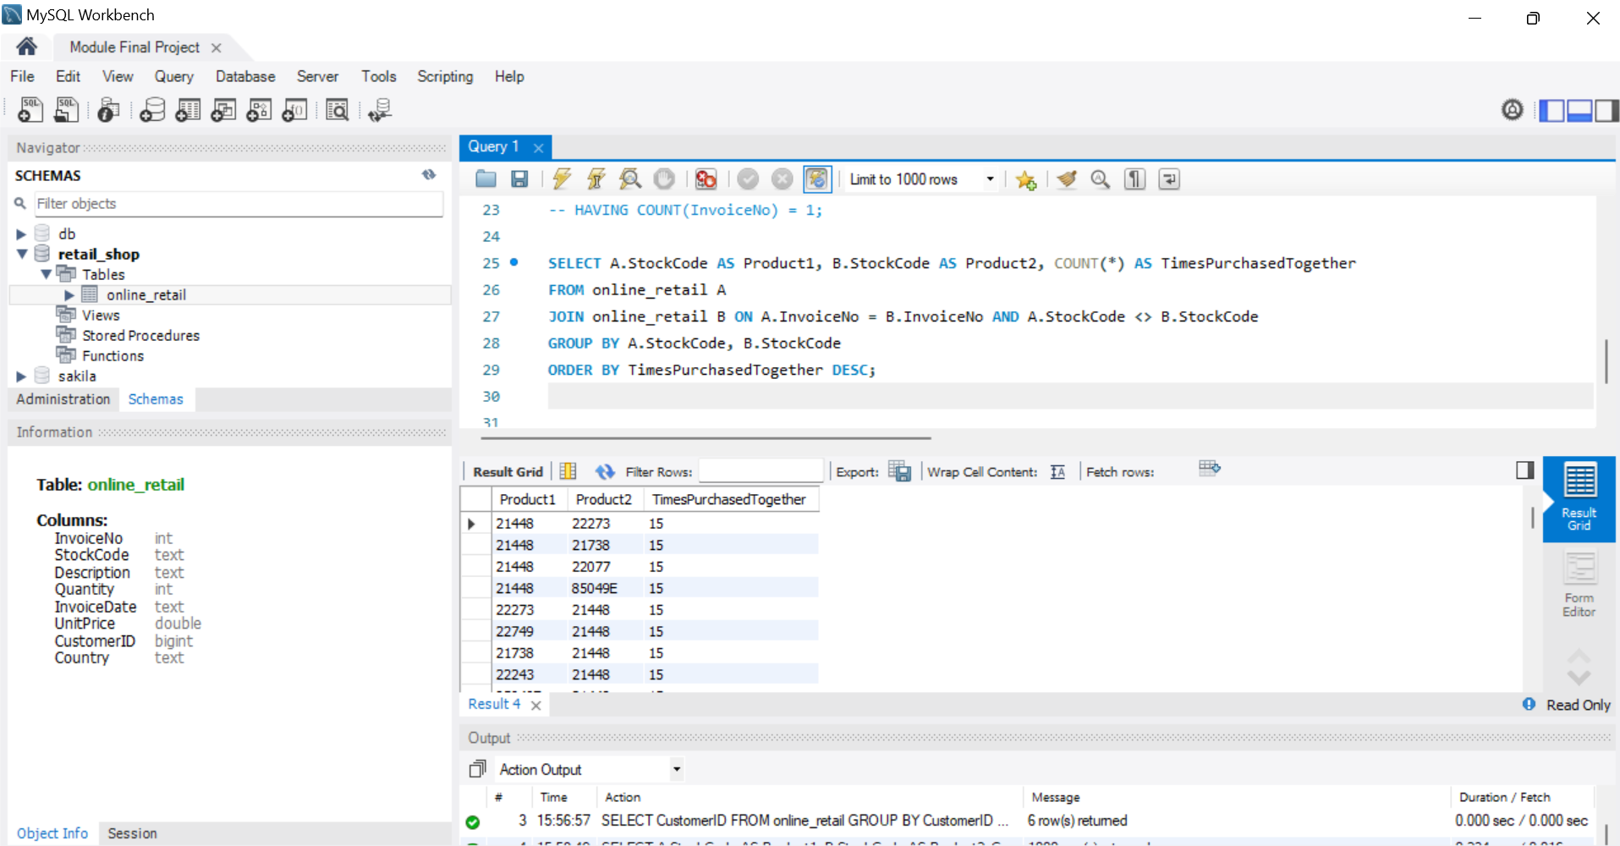
Commonly Purchased Products Together

Slide 10
Advance Queries Overview
1. Customer Segmentation by Purchase Frequency
2. Average Order Value by Country
3. Customer Churn Analysis
4. Product Affinity Analysis
5. Time-based Analysis

Slide 11
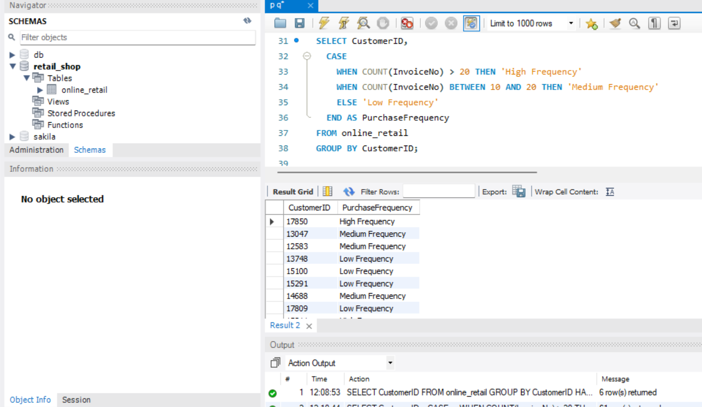
Customer Segmentation by Purchase Frequency

Slide 12
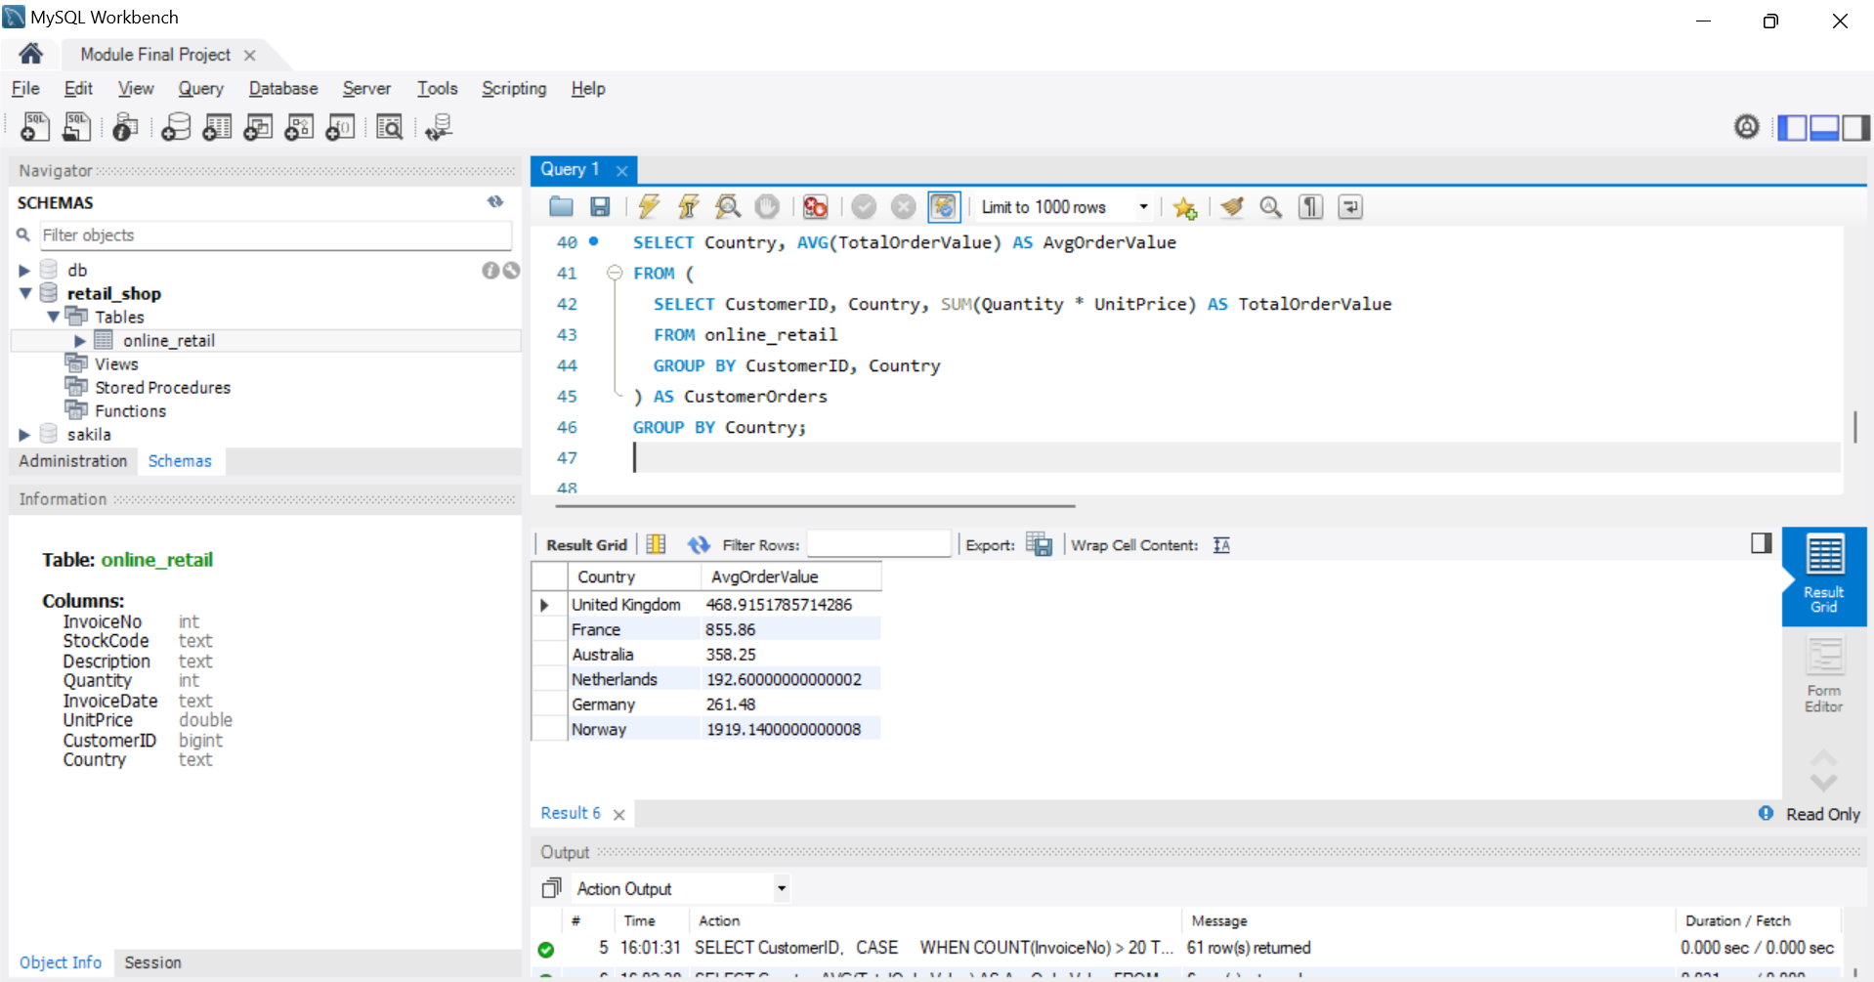
Average Order Value by Country

Slide 13
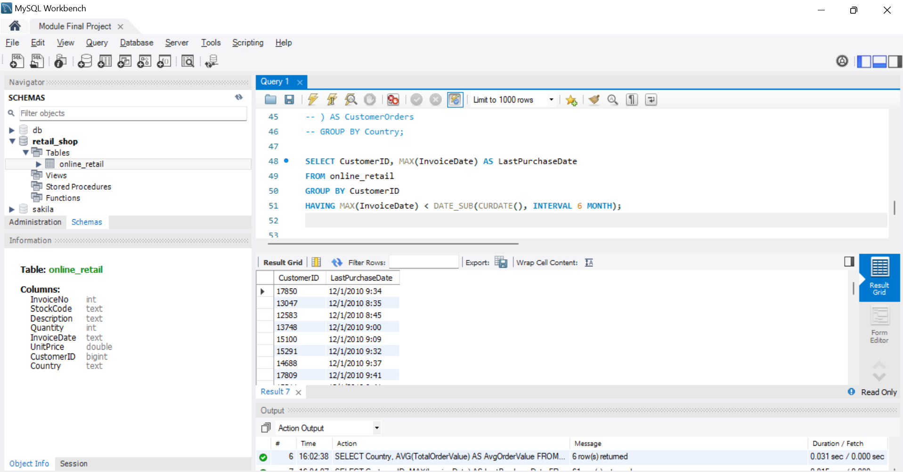
Customer Churn Analysis

Slide 14
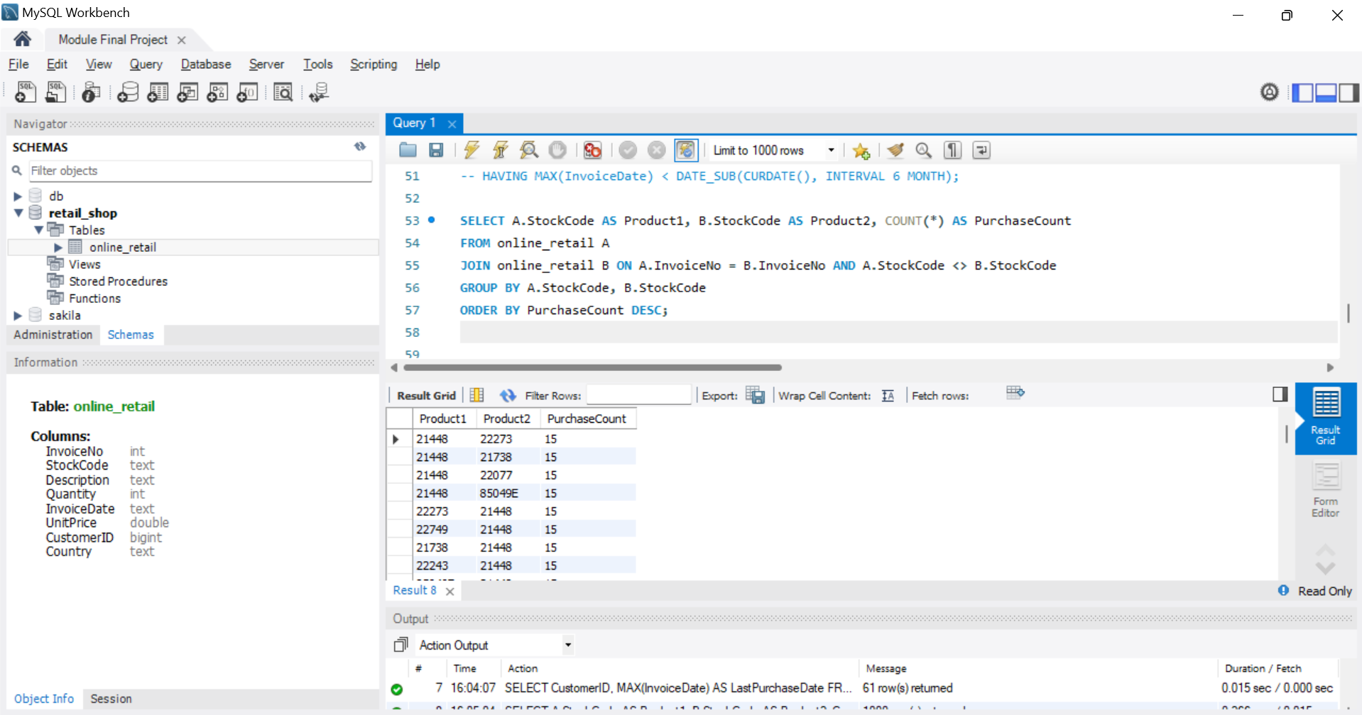
Product Affinity Analysis

Slide 15
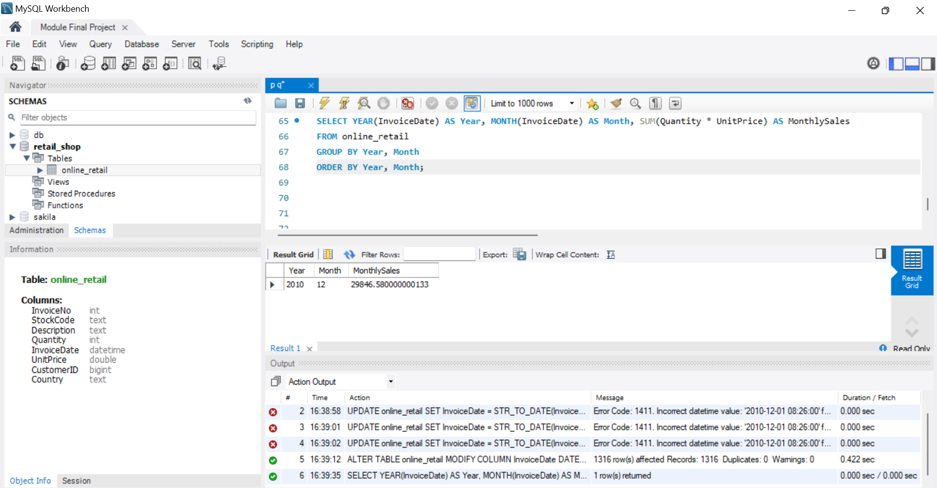
Time-based Analysis

